Slide 1
Dash
Click to start
(Recomended press F5 on keyboard)

Slide 2
Dash
Game
Crstman
Wait while loading We recomend to set the coursor always visible by cliking on the 3 dots
Click 2
Click 3
Click 1
Click to start

Slide 4



Dash
Game
Creditos
Tutorial
1
2
3
4
5
6
7
8
9
10
11
12
13
14
15
16
18
20
20
21
22
23
24
25
26
27
28
Desbloquear todo
Click to start

Slide 5
Game
Game
Tutorial
Loading tutorial
Click to start

Slide 6

Game
Game
Tutorial
Before start get on this circle so you start on a safe zone
Notes: no traslation yet
Click the start to finish the level
It kills you D:
It kills you adn can move
???
You can click it to interact with it
It kill you adn sometimes disapear
Click to start

Slide 8
You died
*Try again?
Yes
No

Slide 9
Game
Game
Ponte adentro
Click to start

Slide 10
Game
Game
Click to start

Slide 11
Game
Game
Felicidades pasate el nivel 1
(Continuar)
Click to start

Slide 12
Dash
Game
Creditos
Tutorial
1
2
3
4
5
6
7
8
9
10
11
12
13
14
15
16
18
20
20
21
22
23
24
25
26
27
28
Click to start

Slide 13
Game
Game
Ponte adentro
Click to start

Slide 15
Game
Game
Click to start

Slide 16
Game
Game
Felicidades pasate el nivel 2
(Continuar)
Click to start

Slide 17
Moriste
*¿volver a intentar?
Si
No

Slide 18
Dash
Game
Creditos
Tutorial
1
2
3
4
5
6
7
8
9
10
11
12
13
14
15
16
18
20
20
21
22
23
24
25
26
27
28
Click to start

Slide 19
Game
Game
Ponte adentro
Click to start

Slide 21
Game
Game
Ponte adentro
c
c
c
c
c
c
c
c
c
c
c
Click to start

Slide 22
Moriste
*¿volver a intentar?
Si
No

Slide 23
Game
Game
Ponte adentro
Felicidades pasate el nivel 3
(Continuar)
Click to start

Slide 24
Dash
Game
Creditos
1
2
3
4
5
6
7
8
9
10
11
12
13
14
15
16
18
20
20
21
22
23
24
25
26
27
28
Click to start

Slide 25

Game
Game
Tutorial
Notas: si vuelves al tutorial (aqui) te regresa al nivel 1 o si le picas a otro nivel te devuelve a ese y se bloquean los otros niveles
On a boss fight every objet but the sword kills you
Click here to atack the boss
Click to start

Slide 26
Game
Game
Ponte adentro
Click to start

Slide 28
Game
Game
Click to start

Slide 29
Moriste
*¿volver a intentar?
Si
No

Slide 30
Game
Game
Felicidades pasate el nivel 4
(Continuar)
Click to start

Slide 31
Dash
Game
Creditos
1
2
3
4
5
6
7
8
9
10
11
12
13
14
15
16
18
20
20
21
22
23
24
25
26
27
28
Click to start

Slide 32
Moriste
*Lo lograras
Reintentar
Rendirse

Slide 33
Game
Game
Ponte adentro
Click to start

Slide 35









Slide 37
-10

Slide 39







Slide 41
-20

Slide 43




Slide 45
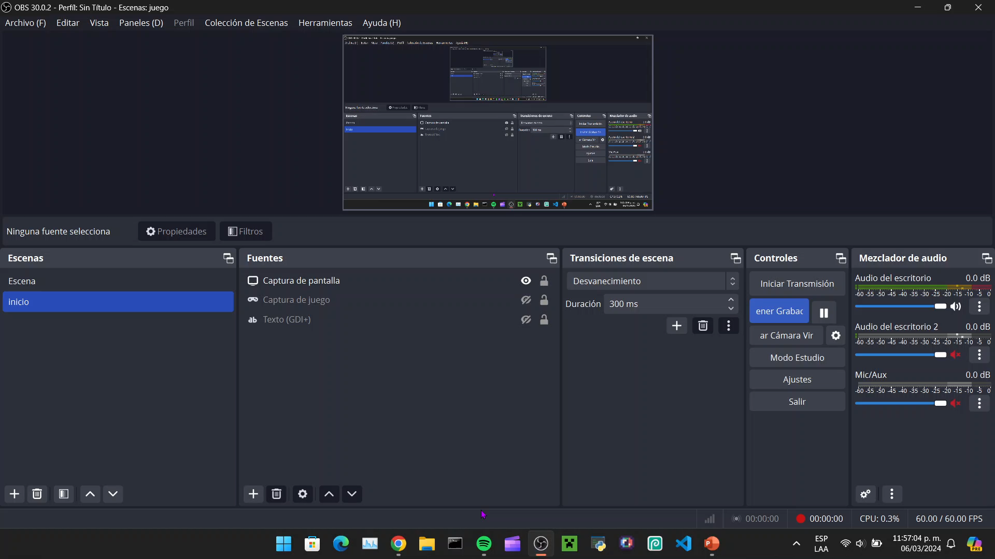
-20

Slide 47
-10

Slide 49
-10

Slide 50
Creditos
[Felicidades] derrostaste al [Rey]
(Continuar)
Click to start

Slide 52
Dash
Game
Creditos
1
2
3
4
5
6
7
8
9
10
11
12
13
14
15
16
18
20
20
21
22
23
24
25
26
27
28
Click to start

Slide 53
Moriste
*¿Volver a intentar?
Si
No

Slide 54
Game
Game
Ponte adentro
Click to start

Slide 56
Game
Game
Click to start

Slide 57
Game
Game
Felicidades pasate el nivel 6
(Continuar)
Click to start

Slide 59
Dash
Game
Creditos
1
2
3
4
5
6
7
8
9
10
11
12
13
14
15
16
18
20
20
21
22
23
24
25
26
27
28
Click to start

Slide 60
Game
Game
Ponte adentro
Click to start

Slide 62

Game
Game
Click to start

Slide 63
Game
Game
Felicidades pasate el nivel 7
(Continuar)
Click to start

Slide 64
Dash
Game
Creditos
1
2
3
4
5
6
7
8
9
10
11
12
13
14
15
16
18
20
20
21
22
23
24
25
26
27
28
Felicidades pasate el nivel 7
(Continuar)
Click to start

Slide 65
Moriste
*¿Volver a intentar?
Si
No

Slide 66
Game
Game
Ponte adentro
Click to start

Slide 68
Game
Game

Slide 69
Game
Game
Felicidades pasate el [nivel 8]
(Continuar)

Slide 70
Dash
Game
Creditos
1
2
3
4
5
6
7
8
9
10
11
12
13
14
15
16
18
20
20
21
22
23
24
25
26
27
28
Click to start

Slide 71
Moriste
*¿Volver a intentar?
Si
No

Slide 72
Game
Game
Ponte adentro

Slide 74
Game
Game
v
v
v
v
v
v
v
v
v
v
v
vv
v
v
v

Slide 75
Felicidades pasaste nivel 9
v
Game
v
v
v
v
v
v
v
v
v
v
v
v
vv
v

Slide 76
Dash
Game
Creditos
1
2
3
4
5
6
7
8
9
10
11
12
13
14
15
16
18
20
20
21
22
23
24
25
26
27
28
Click to start

Slide 78
Moriste
*Lo lograras
Reintentar
Rendirse

Slide 80
Crstman

Slide 82
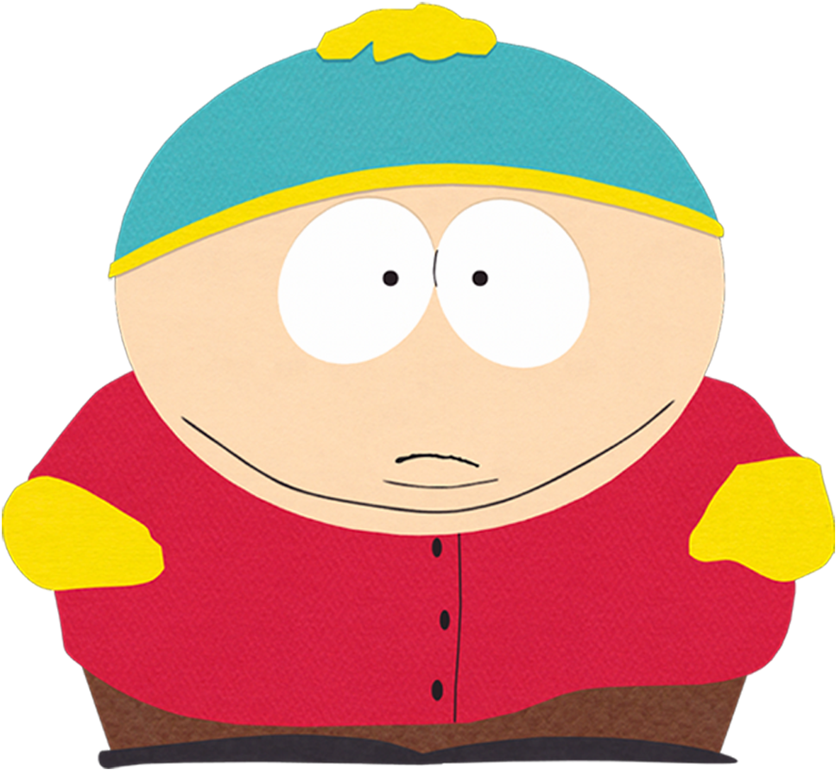
Crstman

Slide 84
Crstman

Slide 85
Crstman

Slide 87
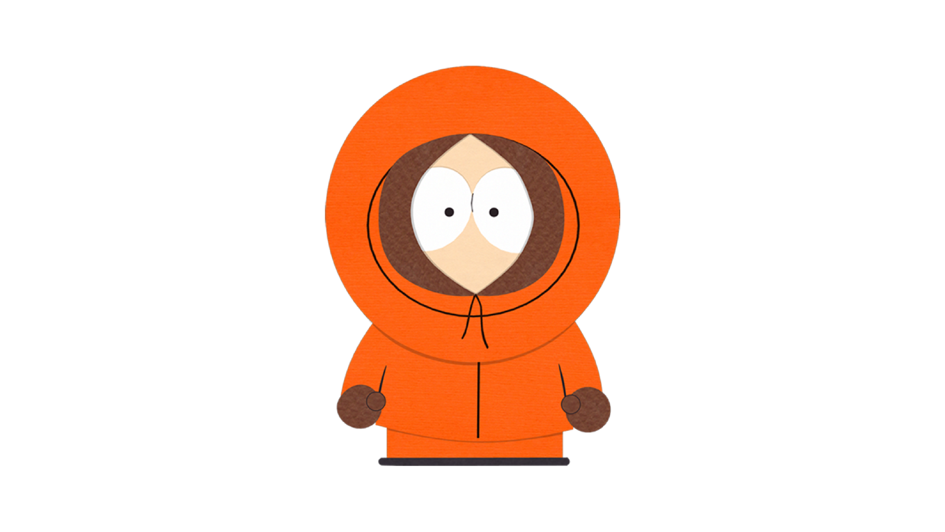
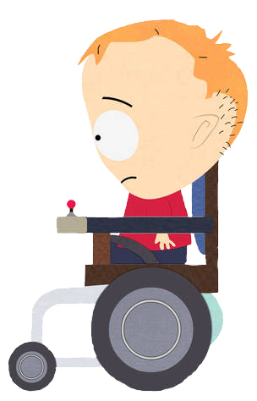
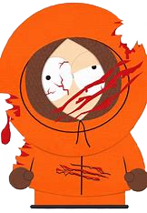
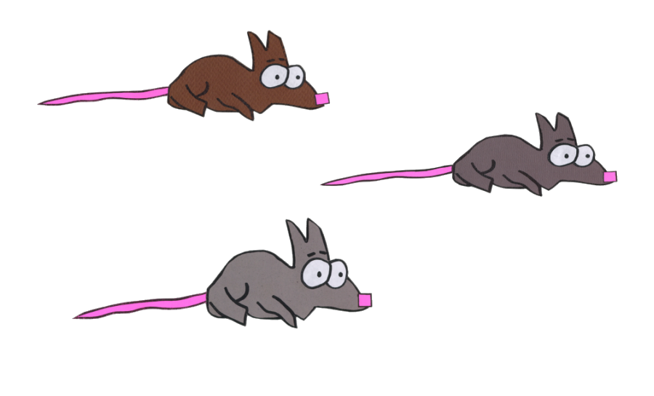


Crstman

Slide 89

Crstman

Slide 90



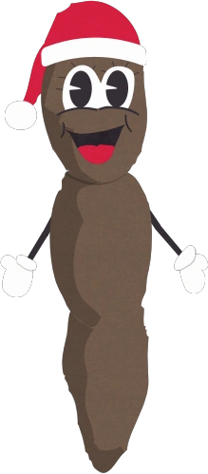

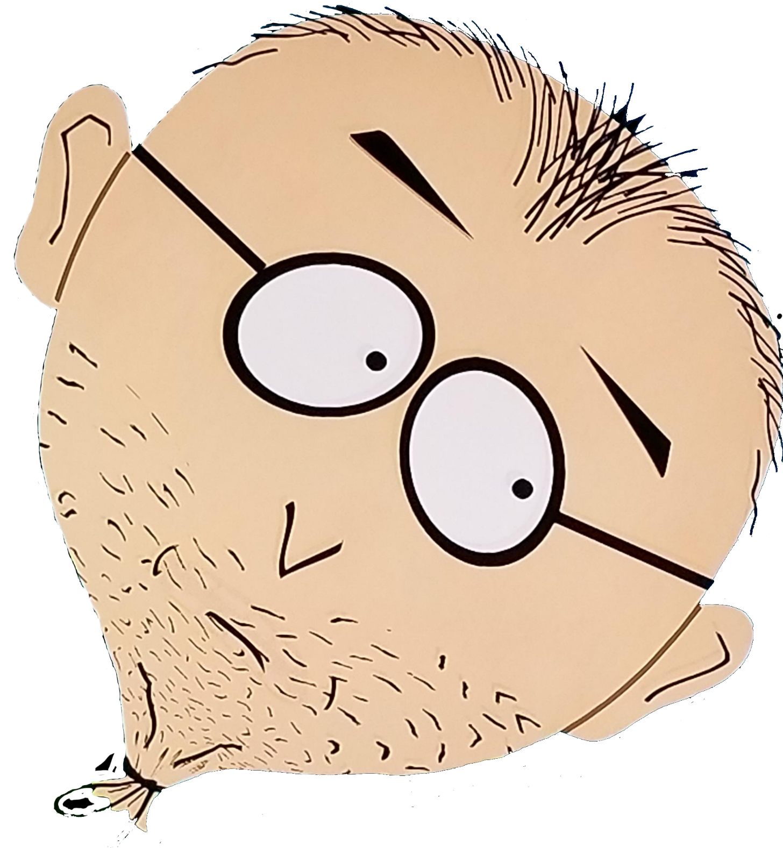
South park
!
!
OK
OK
OK

Slide 92
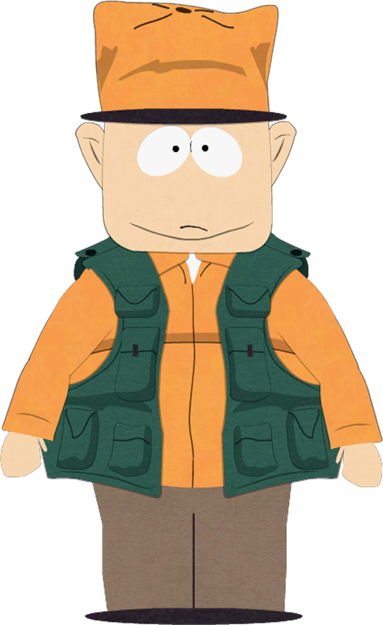
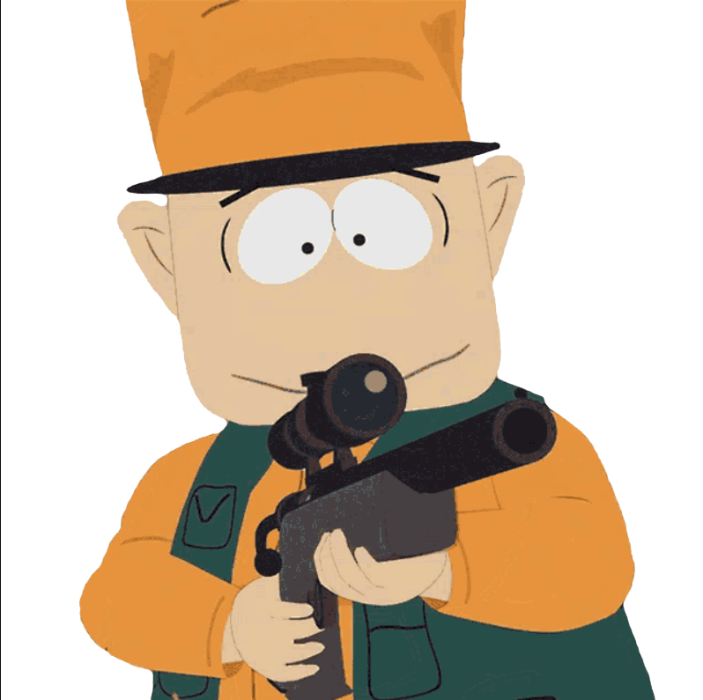
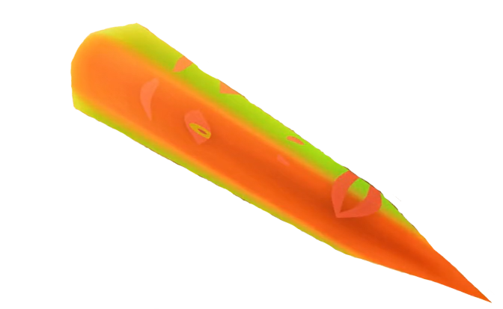
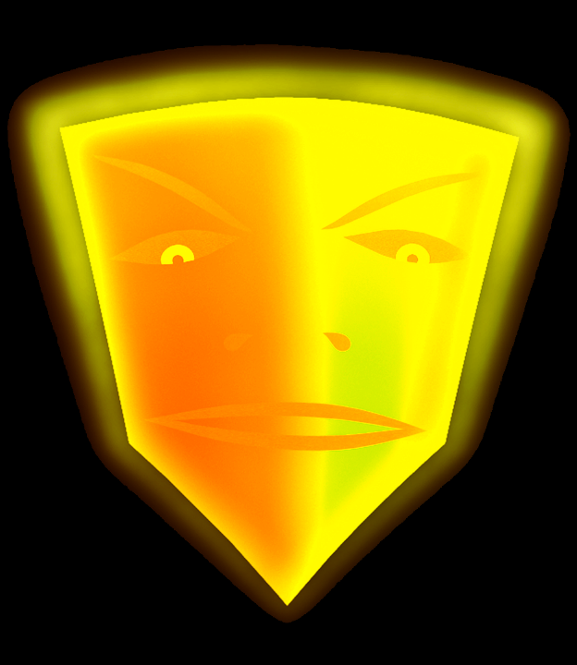
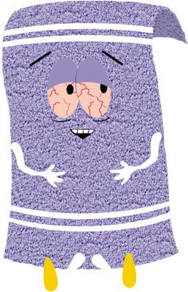
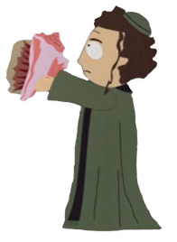

Slide 93
Autoscroll
Dash – Game name idea Uriel (school friend)
Idea del juego – soloxq (creator)
Determination – Toby fox (All defeat boss fight)
Spider dance – Toby fox DP29-33
Efecto de sonido de muerte – Toby fox DP34
Hip hop – Toby fox (Todos los menus)
Enemy aproaching (piano collection) – Toby fox DP21
Poker face cartman edition – los weyes de south park creo DP80-87
Eso por el momento

Slide 95
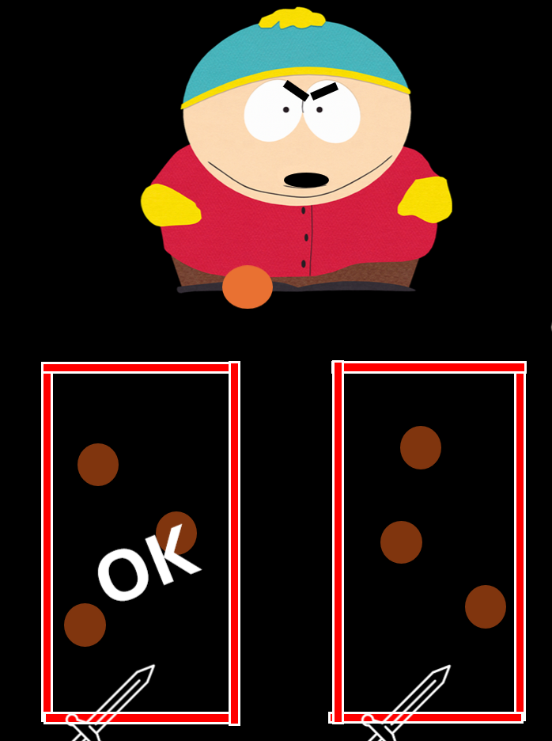
ON A BREAK
BACK SOON
GAME MADE ON
POWEPOINT

